Slide 1

Azure SQL Data Warehouse Redefining MPP How it stacks against Snowflake & RedShift
Oscar Zamora
@ZamoraO linkedin.com/in/ozamora ozamora.com

Slide 2
Agenda

Slide 3
Agenda
What is Azure SQL Data Warehouse
Azure SQL Data Warehouse Architecture
Key differences with SQL Server
Compare against Snowflake
Compare against Redshift
Azure SQL DW T-SQL Sample for loading data
Q & A Session

Slide 4
What is Azure SQL Data Warehouse

Slide 5
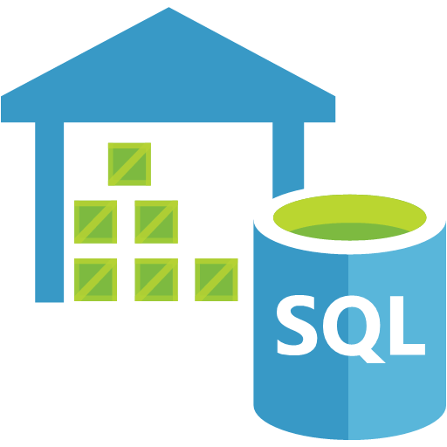
What is Azure SQL Data Warehouse
A cloud iteration of APS (formerly PDW)
A cloud-based Enterprise Data Warehouse (EDW) that uses Massively Parallel Processing (MPP)
Allows running complex SQL across terabytes of data leveraging multiple nodes
Accepts fast ingestion of data using Polybase
With scalable compute and limitless storage
Notes:
APS = Analytics Platform System
PDW = Parallel Data Warehouse
MPP = Massive Parallel Processing

Slide 6
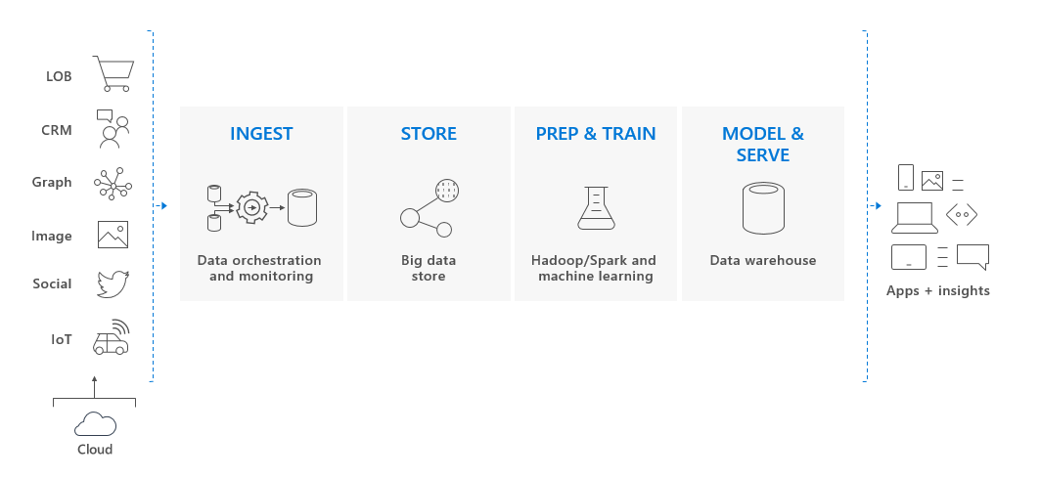
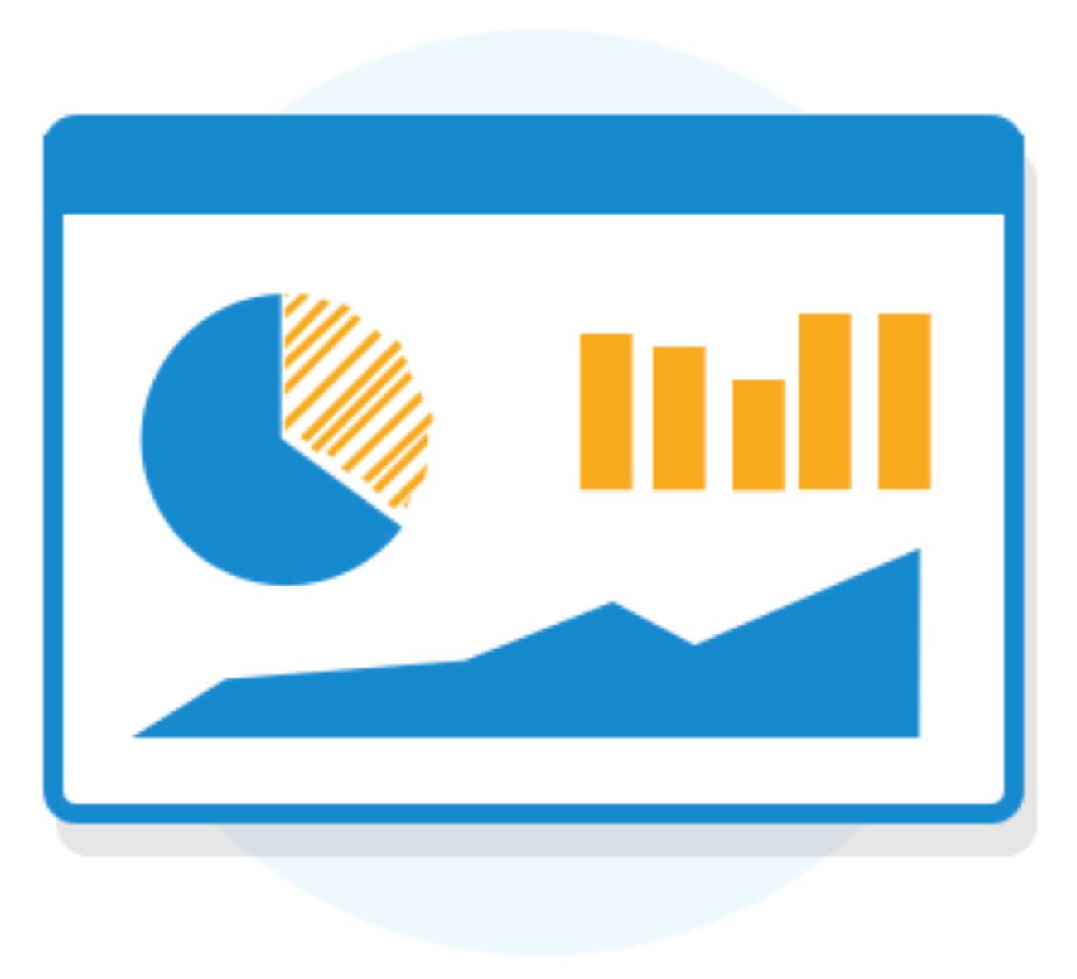
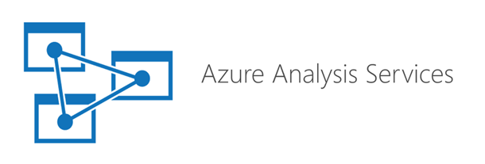
What is Azure SQL Data Warehouse
Notes:
APS = Analytics Platform System
PDW = Parallel Data Warehouse
MPP = Massive Parallel Processing

Slide 7
Azure SQL Data Warehouse Architecture

Slide 8
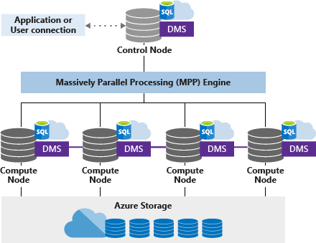
Azure SQL Data Warehouse Architecture
Node based
Control Node
Compute Nodes
Decoupled Storage
Distributed Datafiles
Blob Storage
Local NVMe caching

Slide 9
Azure SQL Data Warehouse Compute
Control Node:
Single Master (gen. 2) funnels queries and returns data
Governed by AAD for authentication and RBAC
Creates query plan and distributes queries
Aggregates/combines results and sends back to client
Compute Nodes:
Perform parallel work (1 to 60 nodes).
Interact with dedicated databases.
Caches data on local NVMe Storage (gen. 2)
Notes:
AAD = Azure Active Directory
RBAC = Role based access control

Slide 10
Azure SQL Data Warehouse Storage
Independent to the control and compute nodes
Data located in 60 distributions
Distributions attached to 1 to 60 compute nodes
Leverages Azure BLOB behind the scenes
Data is Geo-replicated
3 types of data distributions: Hash, Round-Robin, Replicated

Slide 11
Azure SQL DW Latest Optimizations (May)
Result-set caching
Materialized Views
Ordered Clustered Columnstore Index
Workload Importance (priorization)
Auto-update Statistics
JSON support
Dynamic Data Masking

Slide 12
Key differences with SQL Server

Slide 13
Key Differences with SQL Server
SQL Server | Azure SQL DW
Single Node, Multi-processor architecture | Massively Parallel Processing architecture
Requires attached storage or SAN | Storage is decoupled from the node(s)
Supports advanced development (CLR, R) | Most (not all) T-SQL capabilities
Data does not need to conform to distributions | Data needs to be distributed to operate efficiently
Scale Up capabilities (CPU clock, RAM) | Scale Out Capabilities (up to 60 nodes)
Caching limited by RAM | Caching increases as node count is increased
Highly operational DBA tasks (on premises), for backups, maintenance, etc | PaaS platform minimizes operational work

Slide 14
Key Differences with SQL Server
SQL Server | Azure SQL DW
OLTP and OLAP implementations (limited by resources) | OLAP based implementations with multi terabyte/petabyte scale data storage
Highly configurable (partitioning, compression, indexed views, computed, columns, columnar, etc.) | Techniques around data distribution and storage, only.
Available Integration, Reporting and Analytical Engines | Just an MPP engine. Additional services require Azure offerings.
Best for application based services, and Reporting of medium-sized data | Best for very large data analytics, large scale ELT, and data mining services.

Slide 15
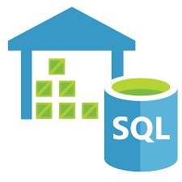

Azure SQL DW vs. Snowflake

Slide 16
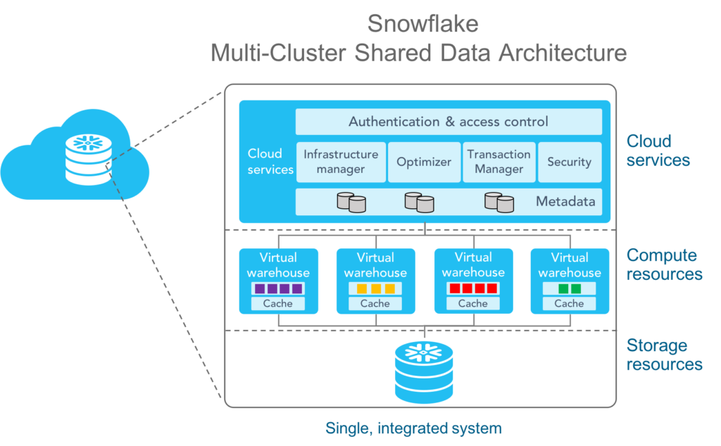
Snowflake Architecture
3 layers
Cloud Services
Compute
Storage

Slide 17
Architecture Side by Side
Azure SQL DW | Snowflake
Multiple Compute Nodes 1 Control Node 1 Cluster (up to 60 nodes) Decoupled Storage | Multiple Compute Nodes Multi-Master Multi-Cluster (up to 128 nodes / 10 clusters) Decoupled Storage
50+ Regions Geo-Replication included | 2 Regions Under Azure 5 Regions Under AWS No Geo-Replication / Cross-Cloud not possible
Increase/decrease Compute Nodes: manual | Increase/decrease Compute Nodes: manual Spin up/down clusters: automatic (Enterprise+)
Database Files accessed by Compute Node(s) Database Files on Blob Storage | Shared Data Architecture Database Objects on Blob Storage
Insert, Update, Delete operations append and flag data within data files. Index maintenance cleans. | Insert, Update, Delete operations create new Blob objects, and updates metadata
Compression: Heap and Column-Store Indexes | Compressed data and Columnar store by default No rowstore option

Slide 18
Architecture Side by Side
Azure SQL DW | Snowflake
Automatic Distribution of Data. 3 options: Hash Round-Robin Replicate | No Distribution Keys
Indexing support | No Indexes supported
Customized Partitioning Support | Automatic micro-partitions (not user-configurable)
Statistics maintenance is possible and suggested | No Statistics maintenance
Clustered index column possible on heap and column store indexed tables. | Unmanaged Clustered data. Re-clustering optionally and strongly suggested for very large tables/heavy DML
Per Cluster Limit: Up to 125 queries running concurrently (gen 2). | Per Cluster Limit: Up to 80 queries running concurrently: 8 queries running concurrently per Cluster 10 Clusters per Virtual Warehouse allowed

Slide 19
Pricing Models
Azure SQL DW | Snowflake
Per-Hour Billing | Per-Second Billing
Per-Terabyte pricing: Data (compressed) 7-day incremental snapshots Geo-replicated Data | Per-Terabyte pricing: Data (compressed), Fail-Safe (7 days), Time-Travel (default 1 day, up to 90)
Data Ingress unlimited, no-cost | Data Ingress unlimited, no-cost
Data Egress Charged per GB per Region | Data Egress Charged per GB per Region

Slide 20




Reference Architecture – Azure SQL DW
Ingest
Store
Prep & train
Model & serve20
Logs (unstructured)
Azure Databricks
Media (unstructured)
PolyBase
Files (unstructured)
Azure Data Factory
Azure Data Lake Store
Azure SQL Data Warehouse
Power BI
Business/custom apps
(structured)
Microsoft Azure also supports other Big Data services like Azure HDInsight and Azure Data Lake to allow customers to tailor the above architecture
to meet their unique needs.

Slide 21

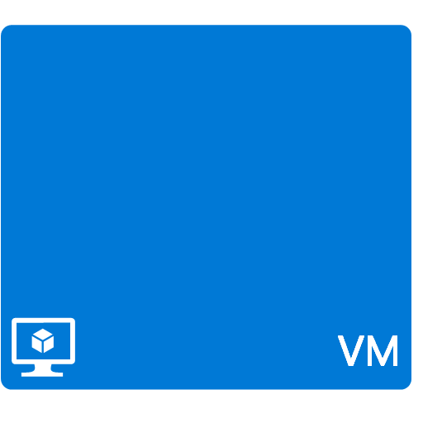
Reference Architecture - Snowflake
Ingest
Store
Prep & train
Model & serve
Federation Service
Logs (unstructured)
Azure Databricks
Media (unstructured)
Snowflake CLI
Files (unstructured)
Azure Data Factory
Azure Data Lake Store
Power BI
Dedicated Compute
Business/custom apps
(structured)
Microsoft Azure also supports other Big Data services like Azure HDInsight and Azure Data Lake to allow customers to tailor the above architecture
to meet their unique needs. Federation Trust needs to be enabled for AAD accesss to Snowflake, for login purposes. At the user level, only.

Slide 22

Azure SQL DW vs. Redshift

Slide 23
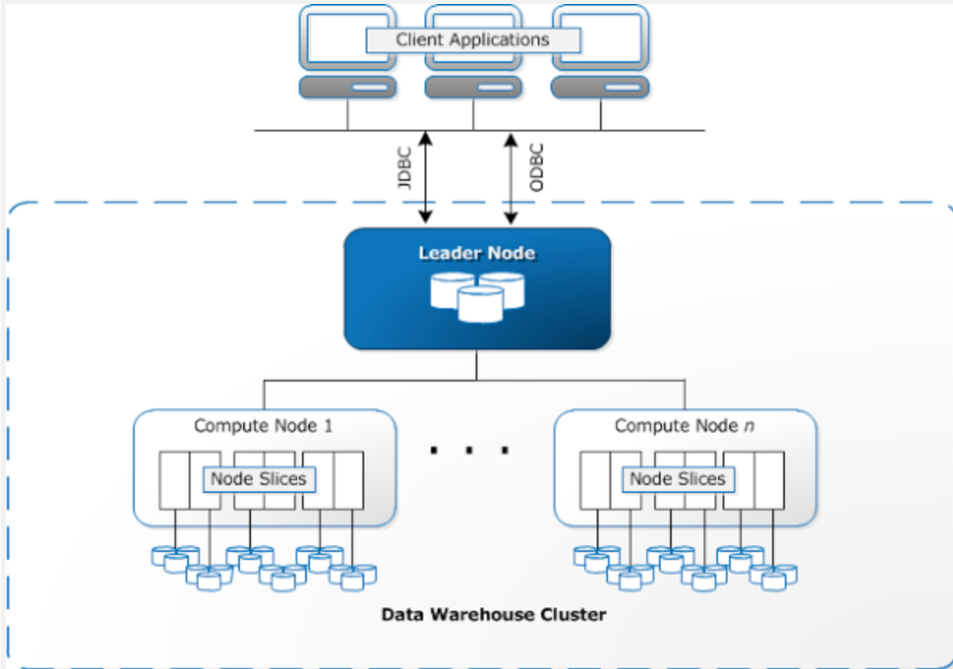
Redshift Architecture
2 layers
Leader Node
Compute Node + attached storage

Slide 24
Architecture Side by Side
Azure SQL DW | Redshift
Multiple Compute Nodes 1 Control Node 1 Cluster (up to 60 nodes) Decoupled Storage | Multiple Compute Nodes 1 Control Node 1 Cluster (up to 32 nodes) Attached Storage
50+ Regions Geo-Replication included | 22 Regions Multiple AZs replication included
Increase/decrease Compute Nodes: manual Compute can be paused anytime | Node resizing is manual. Data requires redistribution @ 1 TB per hour. Reserve instance pricing does not allow pause
Database Files accessed by Compute Node(s) Database Files on Blob Storage | Database objects attached to the Compute Node(s) Database objects are not decoupled from compute
Insert, Update, Delete operations append and flag data within data files. Index maintenance cleans. | Update and deletes flag data. Vacuum required Updates and upserts are not trivial operations.
Compression: Heap and Column-Store Indexes | Columnar data compression. Several algorithms available depending on type of data.

Slide 25
Architecture Side by Side
Azure SQL DW | Redshift
Automatic Distribution of Data. 3 options: Hash Round-Robin Replicate | 4 options: Key (like Hash) Even (like Round-Robin) All (like Replicate) Auto (selected based on size of data)
Indexing support | 1 sort key supported
Customized Partitioning Support | No partitioning
Statistics maintenance is possible and suggested | Vacuuming is required to keep performance
Clustered index column possible on heap and column store indexed tables. | No data clustering support
Per Cluster Limit: Up to 125 queries running concurrently (gen 2). | Per Cluster Limit: Up to 50 queries running concurrently

Slide 26
Pricing Models
Azure SQL DW | Redshift
Per-Hour Billing | Per-Hour Billing
Per-Terabyte pricing: Data (compressed) 7-day incremental snapshots Geo-replicated Data | Data is included per node Dense compute: 0.16TB / 2.56TB Dense Storage: 2TB HDD / 16TB HDD Data is replicated within AZs
Data Ingress unlimited, no-cost | Data Ingress unlimited, no-cost
Data Egress Charged per GB per Region | Data Egress Charged per GB per Region

Slide 27
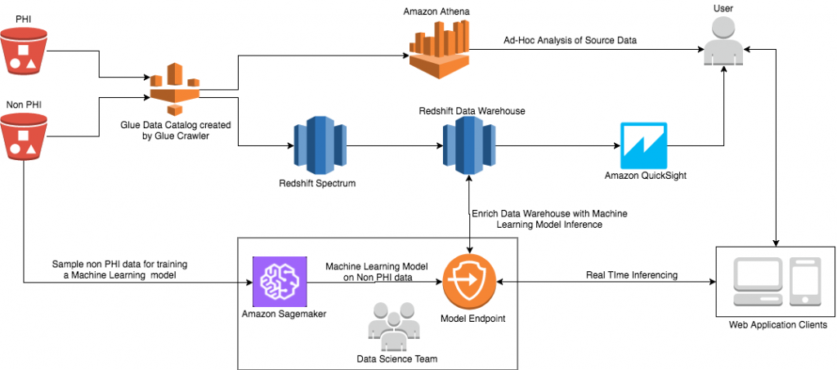
Reference Architecture - Redshift

Slide 28
Price Performance Comparison

Slide 29
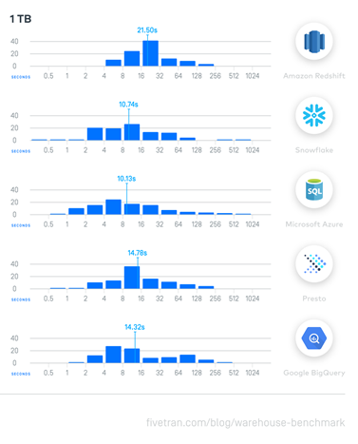
1 TB Query Response Comparison
Source: https://fivetran.com/blog/warehouse-benchmark

Slide 30
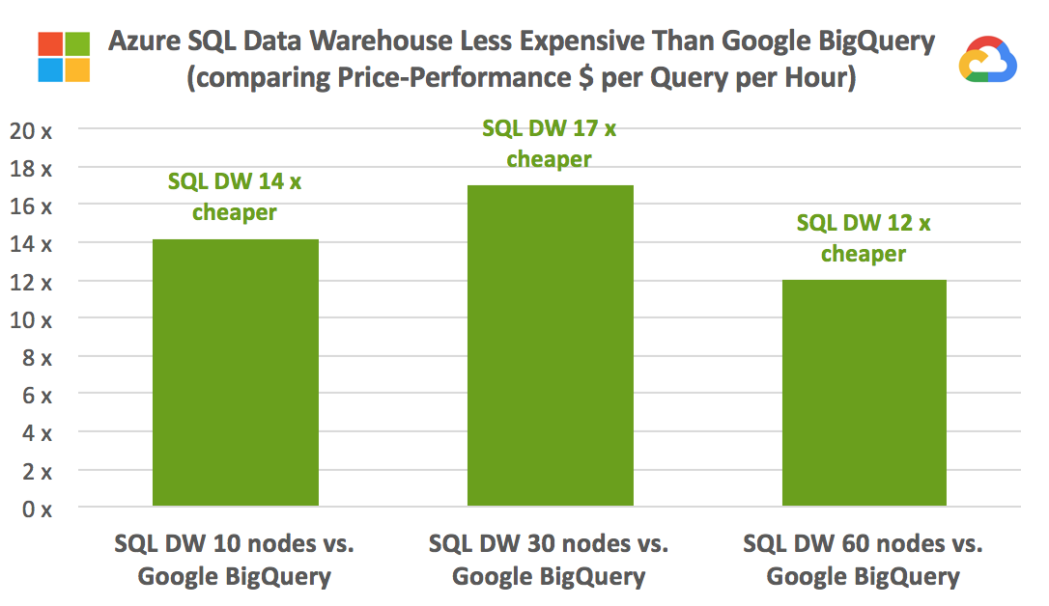
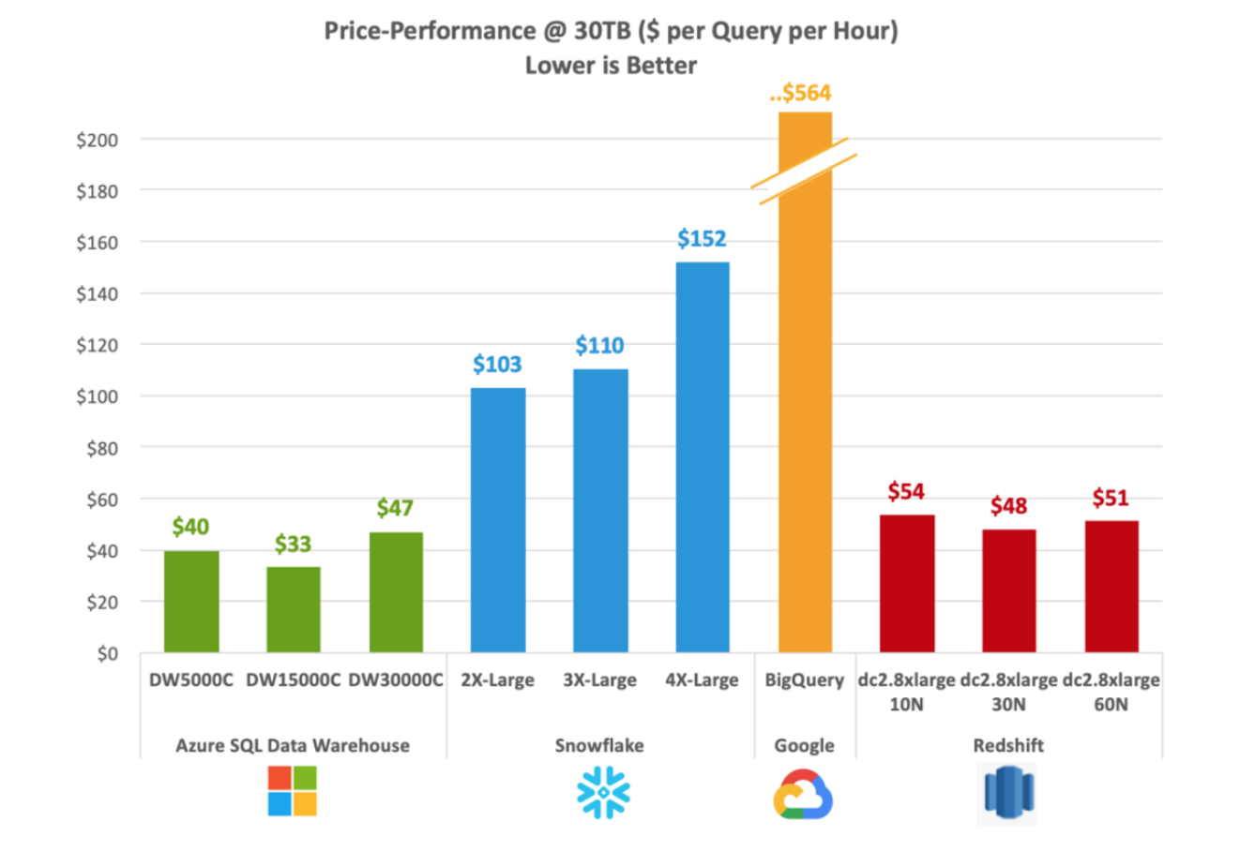
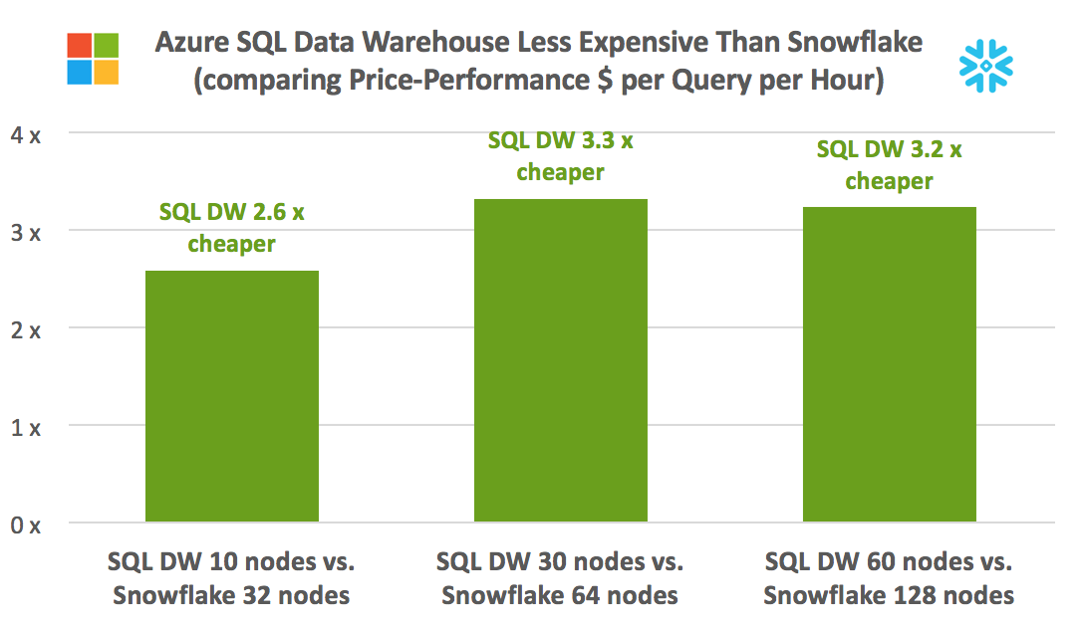
Industry-leading price performance
Source: GigaOm TPC-H 30TB Cloud DW Benchmark (February 2019)
Price-Performance @ 30TB ($ per Query per Hour)
(Lower is Better)
Notes:
From Gigaom Cloud DW Benchmark released February 2018, on the TPC-H 30TB benchmark: https://gigaom.com/report/data-warehouse-in-the-cloud-benchmark/

Slide 31
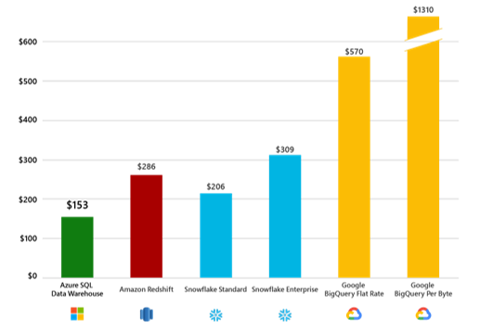
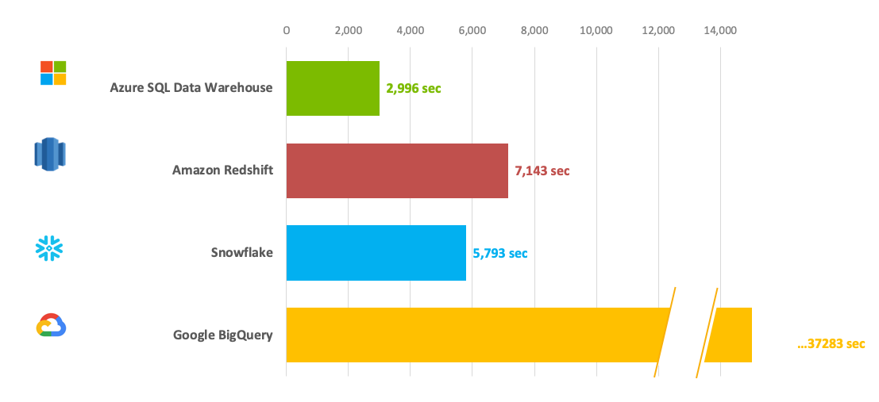
Industry-leading price performance (TPC-DS)
Source: GigaOm TPC-DS Cloud DW Benchmark (April 2019)
Price-Performance @ 30TB ($ per Query per Hour)
(Lower is Better)
Aggregate Execution Time for TPC-DS Queries
(Lower is Better)
Notes:
From Gigaom Cloud DW Benchmark in April 2019, on the TPC-DS 30TB benchmark

Slide 32
Why Azure SQL Data Warehouse?

Slide 33
Enterprise Grade – Multi-Petabyte Scale
ADW has the suite of features needed to handle an enterprise-grade workload
ADW is a SQL-based fully managed, petabyte-scale cloud data warehouse.
It is highly elastic, enabling provision in minutes and scale capacity in seconds.
Independent scaling for compute and storage, allows you to burst compute for complex analytical workloads or scale down your warehouse for archival scenarios.
It integrates easily with products such as Azure Analysis services, HDInsight and Data Lake, offering an end-to-end solution for all your data warehousing needs.
Market leading 99.9% SLA combined with innovative security features provides additional reasons why enterprises should select SQL DW as their go-to cloud based DW product.

Slide 34
Azure SQL Data Warehouse Sample T-SQL Data Loading

Slide 35
Azure SQL DW – Create User for Data Load
-- Execute on Master Database
CREATE LOGIN ozamora WITH PASSWORD = 'iujYTG855w0rd!';
CREATE USER ozamora FROM LOGIN ozamora; -- To create a SQL Server user based on a SQL Server authentication login
-- Execute on target database [DBNAME]
CREATE USER ozamora FROM LOGIN ozamora; -- To create a SQL Server user based on a SQL Server authentication login
GRANT CONTROL ON DATABASE::[DBNAME] to ozamora;
--EXEC sp_droprolemember 'xlargerc', 'ozamora';
--EXEC sp_addrolemember 'staticrc50', 'ozamora';
--EXEC sp_droprolemember 'staticrc50', 'ozamora';
EXEC sp_addrolemember 'staticrc60', 'ozamora';
GRANT VIEW DATABASE STATE TO ozamora;
-- Login as user

Slide 36
Azure SQL DW – Create Table
CREATE TABLE [FINANCE].[TRXN_LINE_DIST]
(
[DIST_KEY_ID] BIGINT NULL,
[DIST_DISCRIM_TYP] varchar(30) NULL,
[GL_PERIOD_START_DT] datetime2(0) NULL,
[ENTERED_AMT] numeric(28, 7) NULL,
[ENTERED_CURRENCY_CD] varchar(15) NULL,
[ACCOUNTED_AMT] numeric(28, 7) NULL,
[DW_CREATE_DT] datetime2(0) NULL,
[DW_LAST_MODIFY_DT] datetime2(0) NULL
)
WITH ( CLUSTERED COLUMNSTORE INDEX, DISTRIBUTION = HASH(DIST_KEY_ID),
PARTITION ( GL_PERIOD_START_DT RANGE RIGHT FOR VALUES
( '2018-01-01', '2018-04-01', '2018-07-01', '2018-10-01' )
)
)

Slide 37
Azure SQL DW – Enable Polybase
CREATE MASTER KEY;
CREATE DATABASE SCOPED CREDENTIAL MyKey
WITH IDENTITY = 'SHARED ACCESS SIGNATURE',
SECRET = 'A4uZYbv8xaYL+RNdAHSl6y/GpyuhvF4h8D7IUHPfcAeKlWwKoAch3Sn2etDaZu7gGtY/KoOhVF99Loh6yBhj0w==';
CREATE EXTERNAL DATA SOURCE EXTLLD
WITH
(
TYPE = HADOOP,
LOCATION = 'wasbs://cilenstage@stage169887.blob.core.windows.net',
CREDENTIAL = MyKey
);
CREATE EXTERNAL FILE FORMAT TextFileFormat
WITH (FORMAT_TYPE = DELIMITEDTEXT, FORMAT_OPTIONS
(FIELD_TERMINATOR = '0x01', STRING_DELIMITER = '"', Encoding = 'UTF8',-- DATE_FORMAT = 'yyyy-MM-dd HH:mm:ss.fff',
USE_TYPE_DEFAULT = FALSE),
DATA_COMPRESSION = 'org.apache.hadoop.io.compress.GzipCodec'
);
GO

Slide 38
Azure SQL DW – Create External Table
CREATE EXTERNAL TABLE [FINANCE].[EXT_TRXN_LINE_DIST]
(
[DIST_KEY_ID] BIGINT NULL,
[DIST_DISCRIM_TYP] varchar(30) NULL,
[GL_PERIOD_START_DT] datetime2(0) NULL,
[ENTERED_AMT] numeric(28, 7) NULL,
[ENTERED_CURRENCY_CD] varchar(15) NULL,
[ACCOUNTED_AMT] numeric(28, 7) NULL,
[DW_CREATE_DT] datetime2(0) NULL,
[DW_LAST_MODIFY_DT] datetime2(0) NULL
)
WITH ( LOCATION='/FINANCE/LINE_DIST/', DATA_SOURCE = EXTLLD, FILE_FORMAT = TextFileFormat, REJECT_TYPE = percentage, REJECT_VALUE = 30, REJECT_SAMPLE_VALUE = 100 );

Slide 39
Azure SQL DW – Load Data
INSERT INTO [FINANCE].[TRXN_LINE_DIST]
SELECT * FROM [FINANCE].[EXT_TRXN_LINE_DIST];
-- CTAS Alternative
CREATE TABLE [FINANCE].[TRXN_LINE_DIST]
WITH ( CLUSTERED COLUMNSTORE INDEX, DISTRIBUTION = HASH(DIST_KEY_ID),
PARTITION ( GL_PERIOD_START_DT RANGE RIGHT FOR VALUES
( '2018-01-01', '2018-04-01', '2018-07-01', '2018-10-01' )
)
)
AS
SELECT * FROM [FINANCE].[EXT_TRXN_LINE_DIST];

Slide 40
Q & A Session

Slide 41
References
https://docs.microsoft.com/en-us/azure/sql-data-warehouse/release-notes-10-0-10106-0
https://azure.microsoft.com/en-us/blog/adaptive-caching-powers-azure-sql-data-warehouse-performance-gains/
https://docs.aws.amazon.com/general/latest/gr/rande.html
https://docs.microsoft.com/en-us/sql/t-sql/statements/create-external-file-format-transact-sql?view=sql-server-2017
https://azure.microsoft.com/en-us/blog/azure-sql-data-warehouse-releases-new-capabilities-for-performance-and-security/
https://docs.microsoft.com/en-us/azure/sql-database/sql-database-features
http://microsoft-bitools.blogspot.com/2017/07/azure-sql-database-vs-azure-sql-data.html

Slide 42


